Slide 1
HR Analytics Consulting People Analytics Case Study
Objective : Predict whether an individual’s salary is > $50K or <= $50K

Slide 2
THE PROBLEM
Context
Problem statement
The data provided represents the US Census data
It has various demographic, education, personal and professional attributes
Based on the data provide create a Machine Learning model that predicts where an individual’s salary is > $50K or <= $50K

Slide 3
DATA UNDERSTANDING
Age
Workclass
fnlwgt
The Age of an individual
Integer greater than 0
General term to indicate employee status of an individual
Categorical Variable
Final Weight
Integer greater than 0
Education
Education-num
Marital-Status
Highest level of Education achieved
Categorical Variable
Highest level of Education achieved in numbers
Integer greater than 0
Marital-Status of an Individual
Categorical Variable

Slide 4
DATA UNDERSTANDING
Occupation
Sex
Occupation of an individual
Categorical Variable
Individual’s Genders
Categorical Variable
Relationship
Represents relation to others
Categorical Variable
Capital Gain
Hours-per-week
Investment Profit
Integer greater than 0
Work hours per week
Integer greater than 0
Salary
Capital Loss
Native-country
Dependent Variable
Categorical Variable
> $50K or <= $50K
Investment Loss
Integer greater than 0
Country of Origin
Categorical Variable

Slide 5
Exploratory Data Analysis

Slide 6
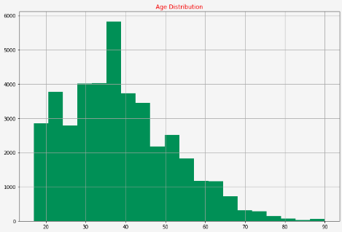
Age
Age variables distribution is right skewed as expected.
Assumption here is the working population mainly lies between 26 to 55 years age group

Slide 7
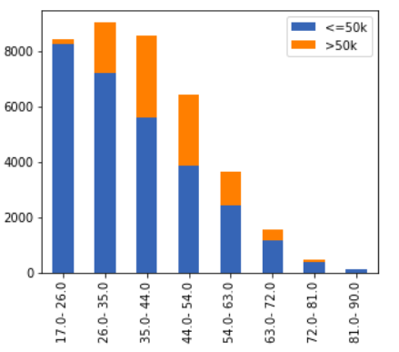
Age
Insights from Age vs Income stacked bar plot
Percentage of people having salaries greater than 50K is considerably higher from 26 to 63 age groups
People below 26 years and above 63 years mostly have salaries below 50K
We decided not to group Age variable as per the bins in the plot as it would have increased the dimensionality of the model considerably (We already have a lot of categorical variables in the data)

Slide 8
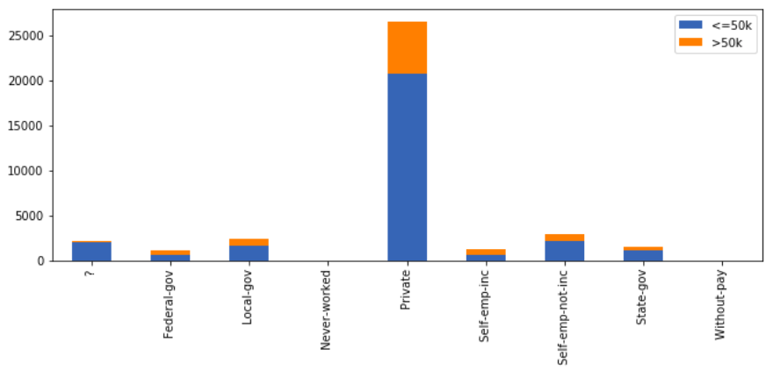
Workclass
Insights from Workclass vs Income stacked bar plot
Federal Gov and Self-emp-inc have the maximum percentage of population above 50K category and have been grouped as Highly-paid
Local and State government employees seem to have similar salary ranges hence clubbed as Govt
?, Never-worked and Without-pay have been grouped as Others

Slide 9
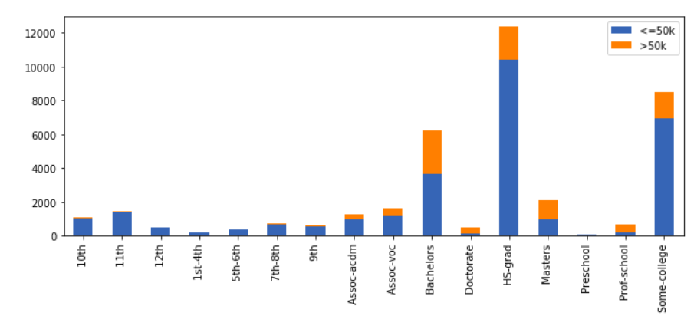
Education
Insights from Education vs Income stacked bar plot and Online Research
Preschool to 12th standard were grouped as Others
Assoc-acdm, Assoc-voc and Prof-School were grouped together as Prof
Doctorate and Masters were grouped together as Highly-Educated

Slide 10
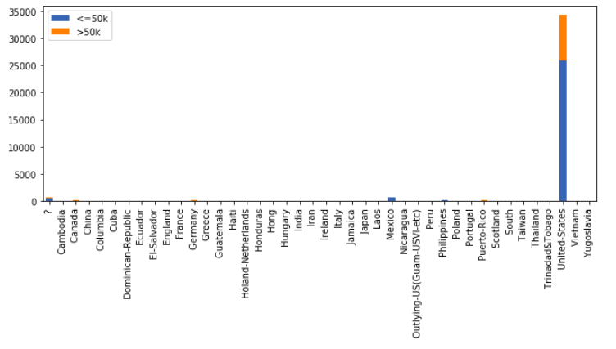
NativeCountry
Insights from NativeCountry vs Income stacked bar plot
All people were grouped into US_citizen and Immigrant

Slide 11
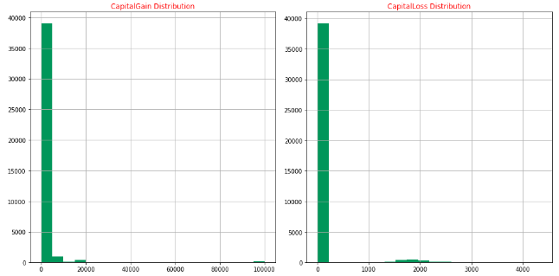
CapitalGain and CapitalLoss
From the above distribution we can see that capital gain and capital loss columns have skewed distribution with maximum values as zero
As we wont get any useful information from these columns we will drop these 2 columns

Slide 12
Missing Data Treatment - Data Imputation
We could have build supervised learning models to predict values on the basis of other variables and then use them along with other variables to predict income.
But as only 6% of data is missing, we can impute numeric variables with Median and categorical variables with Mode
This won't affect the distribution as only about 6% of the data is missing. Hence we used median and mode imputation here

Slide 13
Model Selection and Results

Slide 14
Machine Learning Models
Classification Models used in this solution are :
Logistic Regression Random Forest GBM
XGBoost CatBoost
All the models were giving similar accuracy
But in terms of precision and/or recall Logistic Regression, Random Forest and GBM were not giving good results
XGBoost and CatBoost Algorithms gave better results in terms of precision and recall
Logistic Regression Results
Random Forest Results
GBM Results
Accuracy_score : 0.7837
Precision : 0.5299
Recall : 0.8440
Accuracy_score : 0.8014
Precision : 0.8136
Recall : 0.2200
Accuracy_score : 0.8397
Precision : 0.7253
Recall : 0.5306

Slide 15
XGBoost Results
Performance Metrics on Validation set
Performance Metrics on Train set to check overfitting
Accuracy_score : 0.8426
Precision : 0.7134
Recall : 0.5715
Accuracy_score : 0.8488
Precision : 0.7248
Recall : 0.5959

Slide 16
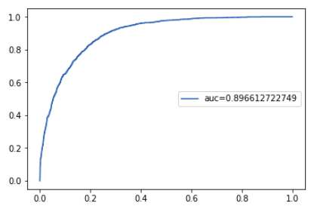
Best Model - CatBoost Results
Performance Metrics on Validation set
Area Under the curve
Accuracy_score : 0.8441
Precision : 0.7178
Recall : 0.5735
Performance Metrics on Train set to check overfitting
Accuracy_score : 0.8468
Precision : 0.7223
Recall : 0.5884

Slide 17
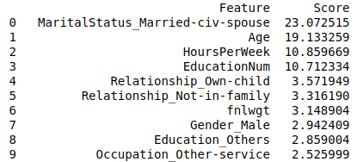
Best Model - Feature Importance
Top 10 features
Some points for further improvement of model
Better results can be achieved we get access to more data
The Model will perform better if we get relevant fields like
Industry - IT, BFSI etc
Workplace Location - Rural, Urban etc...

Slide 18
Model Results on Test Data
The final results are shared in the final.csv file.
The Income column is encoded as below
>50k == 1
<=50k == 0

Slide 19
Thankyou

